Slide 1





Economic Impact of a C nadian Recreational Vehicle Industry 2011

Slide 2



$11.5 billion
$14.5 billion
$8.0 billion
Direct Spending*
Gross Output*
Net Economic*
* Year 2011
Source: 2012, Economic Impact of the Canadian Recreation Vehicle Industry, Recreation Vehicle Dealers Association of Canada
Source: 2014/15 Annual Census of Post-MD Trainees, CAPER

Slide 3
Gross Output DISTRIBUTION by province, 2011
30%
29%
23%
18%
Ontario
Alberta and British C.
First place, $4.2 billion
Third place, $2.2 billion each
Quebec
Atlantic,Manitoba, Saskatchewan and Columbia
Second place, $3.4 billion
Source: 2012, Economic Impact of the Canadian Recreation Vehicle Industry, Recreation Vehicle Dealers Association of Canada

Slide 4
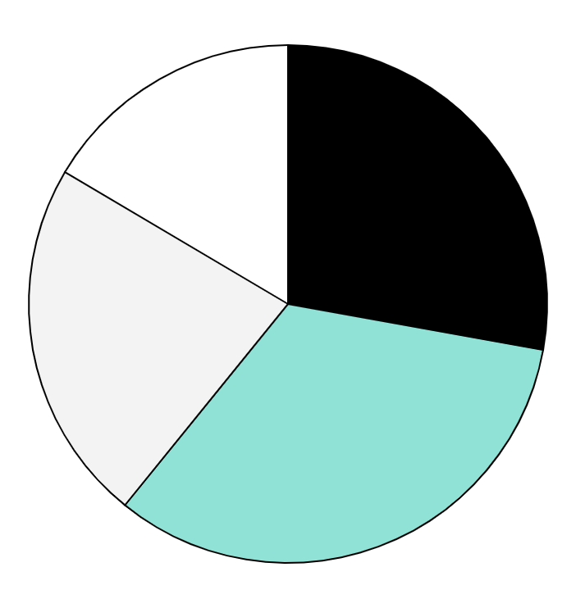
Total RV Trips 2011
22%
28%
Alberta
Ontario
1.7 millions of trips
2.2 millions of trips
16%
32%
British Columbia
Atlantic, Manitoba, Saskatchewan, Quebec
1.3 millions of trips
1.6 millions of trips
Source: 2012, Economic Impact of the Canadian Recreation Vehicle Industry, Recreation Vehicle Dealers Association of Canada

Slide 5


MAIN Conclusions
Ontario
Quebec
British Columbia
Alberta
TODAY
The best option
FUTURE
Good option

Slide 6
THANK YOU
Do you have any questions?
gabrielaleon2783@gmail.com
+249 979 2918
Please keep this slide for attribution

